Slide 1

Visión por Computador
Domingo Mery
Departamento de Ciencia de la Computación
Escuela de Ingeniería
Universidad Católica de Chile
Bias, Fairness, Mitigation

Slide 2
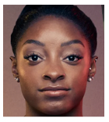
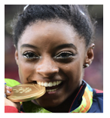
Face Verification
Facial
Matcher
A
Same
Person
(score > )
B

Slide 3
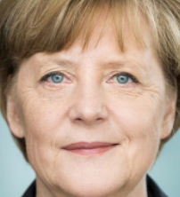
Face Verification
Facial
Matcher
A
Different
Persons
(score < )
[ BLACK BOX ]
B

Slide 4
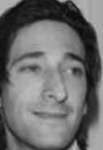
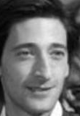
Face Verification
Vectors of n
elements
(1 x n)
Image A
Feature
Extraction
Image B
score:
Similarity using
cos - similarity
Feature
Extraction
If image-A and image-B are from the same person score s is high
If image-A and image-B are from different persons score s is low

Slide 5
Some statistics
same person
Set of Images A
Set of Images B
Face i of set A and Face i of Set B are from the same person.
Face i of set A and Face j of set B for i=j are from different persons.
Face
1
Face
1
Face
2
Face
2
:
:
:
:
Face
m
Face
m
:
:
m x n elements
m x n elements

Slide 6
Some statistics
different persons
Set of Images A
Set of Images B
Face i of set A and Face i of Set B are from the same person.
Face i of set A and Face j of set B for i=j are from different persons.
Face
1
Face
1
Face
2
Face
2
:
:
:
:
Face
m
Face
m
:
:
m x n elements
m x n elements

Slide 7
Some statistics
m x m
elements
Similarity between Face-i of set A and Face-j of set B

Slide 8
Some statistics
d⁺: Diagonal : positive pairs (genuines)
m x m
elements
Similarity between Face-i of set A and Face-j of set B

Slide 9
Some statistics
d⁺: Diagonal : positive pairs (genuines)
d⁻: Non-Diagonal: negative pairs (impostors)
m x m
elements
Similarity between Face-i of set A and Face-j of set B

Slide 10
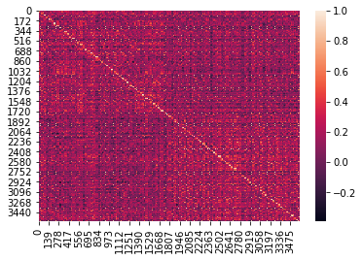
Some statistics
d⁺: Diagonal : positive pairs (genuines)
d⁻: Non-Diagonal: negative pairs (impostors)
m x m
elements
Similarity between Face-i of set A and Face-j of set B

Slide 11
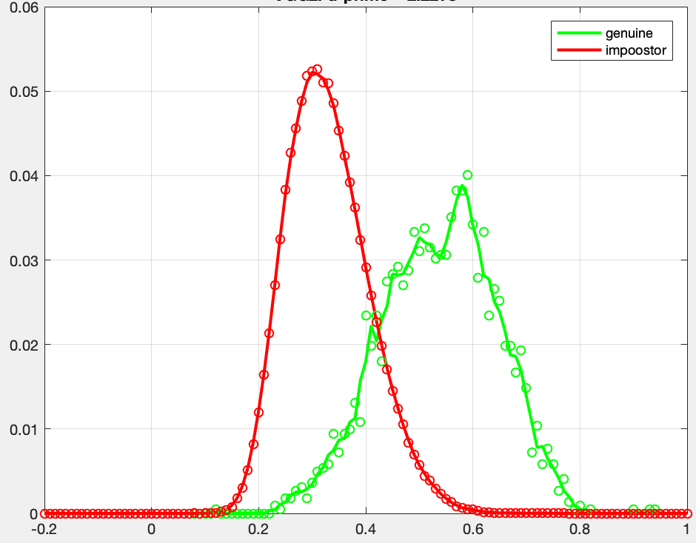

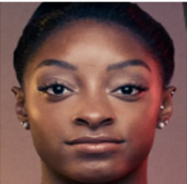
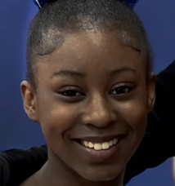
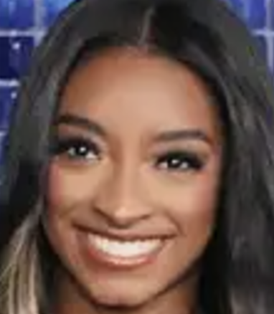
Some statistics
Probability density frequency
ERROR: FMR
ERROR: FNMR
S
Faces of different persons, but they were matched
Faces of the same person, but there is no match
FNMR
False Non-Match Rate
FMR
False Match Rate
threshold

Slide 12
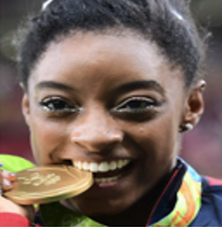
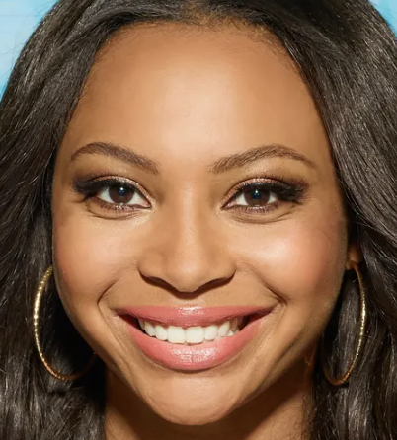
An examples with faces…
POSITIVE PAIRS
Faces of the same person
Match = 0.75
NEGATIVE PAIRS
Faces of different persons
Match = 0.10

Slide 13
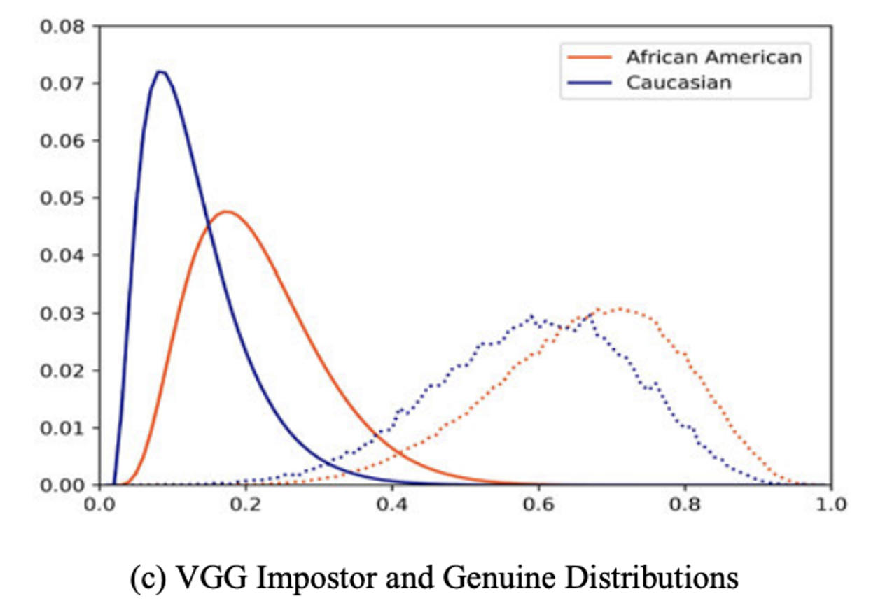
An examples with faces…
NEGATIVE PAIRS
POSITIVE PAIRS
matching
score

Slide 14
An examples with faces…
NEGATIVE PAIRS
POSITIVE PAIRS
Threshold
matching
score

Slide 15
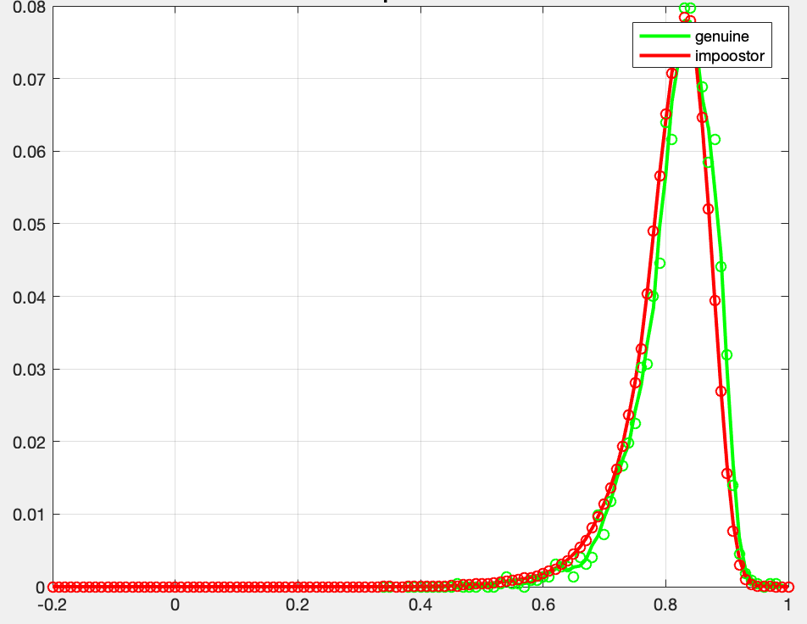
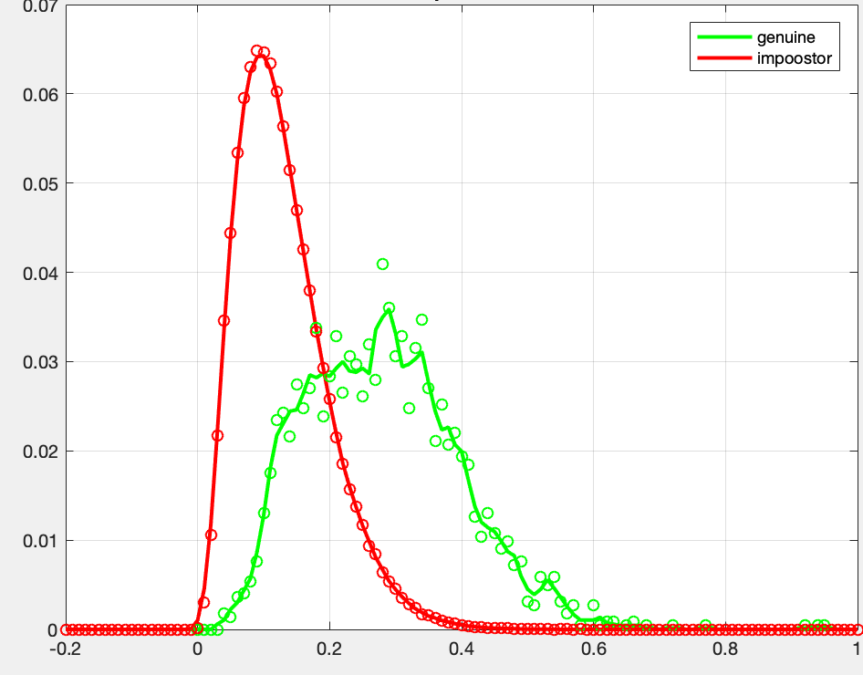
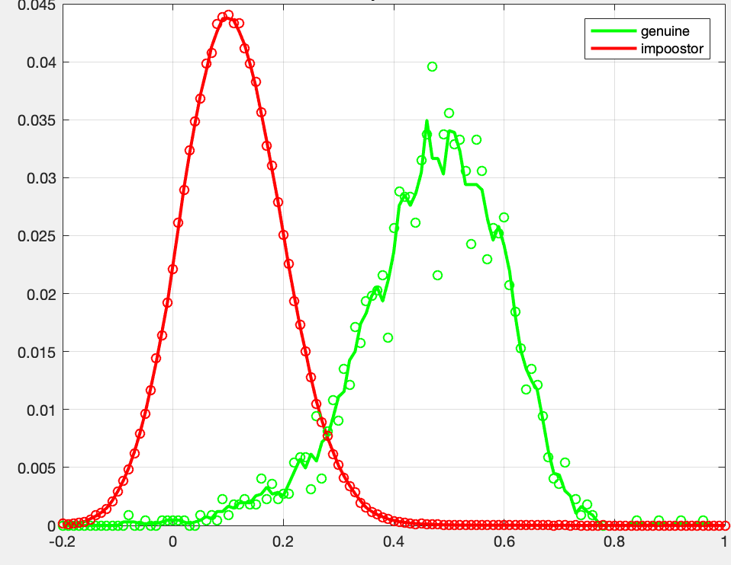
Some statistics
Examples of d’
for different algorithms
d’ = 0.20
d’ = 1.59
d’ = 2.22
d’ = 3.23
The best one

Slide 16
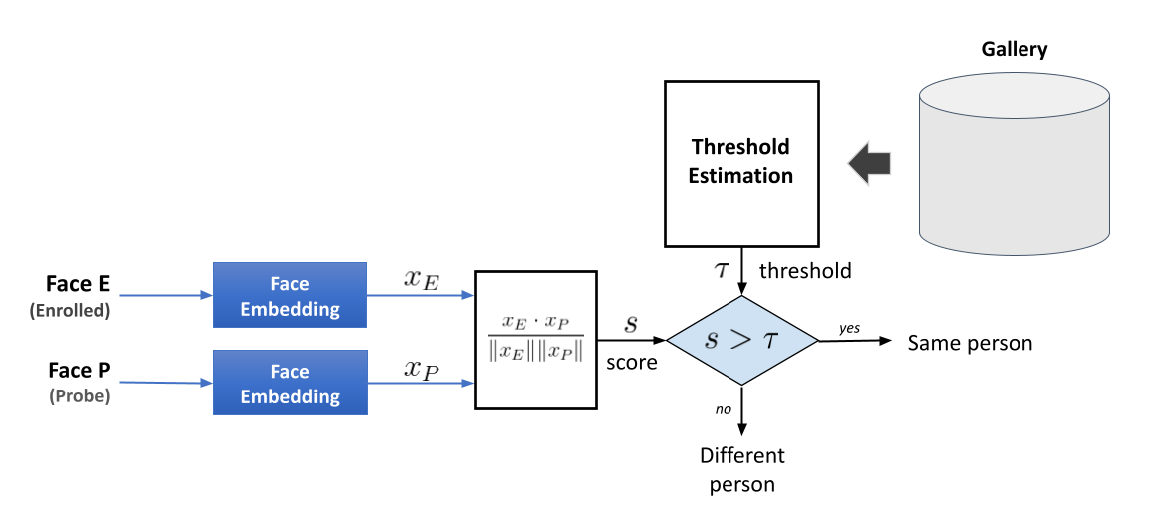
Facial Verification Problem
Introduction - Related Work - Proposed Methods - Methodology - Results - Conclusions
Standard Facial Verification Approach
(c) Esteban Villalobos

Slide 17
An examples with faces…
NEGATIVE PAIRS
POSITIVE PAIRS
Threshold
matching
score

Slide 18
An examples with faces…
NEGATIVE PAIRS
POSITIVE PAIRS
Global
Global
Threshold
matching
score
Vangara, K., King, M. C., Albiero, V., & Bowyer, K. (2019). Characterizing the variability in face recognition accuracy relative to race. In Proceedings of the IEEE/CVF Conference on Computer Vision and Pattern Recognition Workshops

Slide 19
Is the performance of an algorithm the same for all demographic groups?
Unfortunately, it is not ...

Slide 20
An examples with faces…
NEGATIVE PAIRS
POSITIVE PAIRS
Global
Global
Threshold
matching
score
Vangara, K., King, M. C., Albiero, V., & Bowyer, K. (2019). Characterizing the variability in face recognition accuracy relative to race. In Proceedings of the IEEE/CVF Conference on Computer Vision and Pattern Recognition Workshops

Slide 21
An examples with faces…
NEGATIVE PAIRS
POSITIVE PAIRS
Global
Caucasian
Global
Threshold
matching
score
Threshold for
Caucasian

Slide 22
An examples with faces…
NEGATIVE PAIRS
POSITIVE PAIRS
Global
Caucasian
Afro-American
Global
Threshold
matching
score
Threshold for
Caucasian
Threshold for
Afro-American

Slide 23
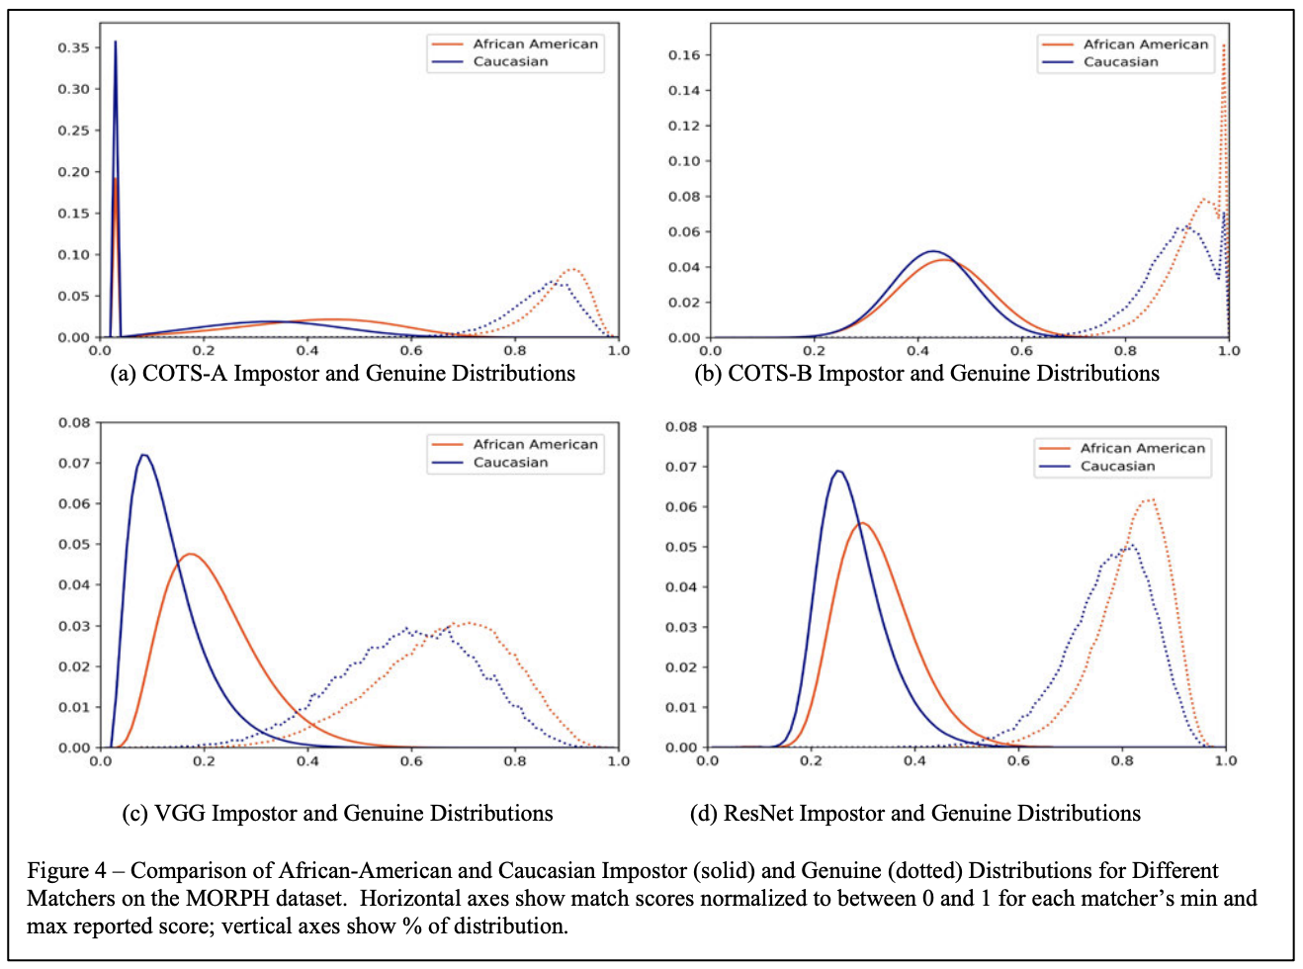
Vangara, K., King, M. C., Albiero, V., & Bowyer, K. (2019). Characterizing the variability in face recognition accuracy relative to race. In Proceedings of the IEEE/CVF Conference on Computer Vision and Pattern Recognition Workshops
https://arxiv.org/abs/1904.07325

Slide 24
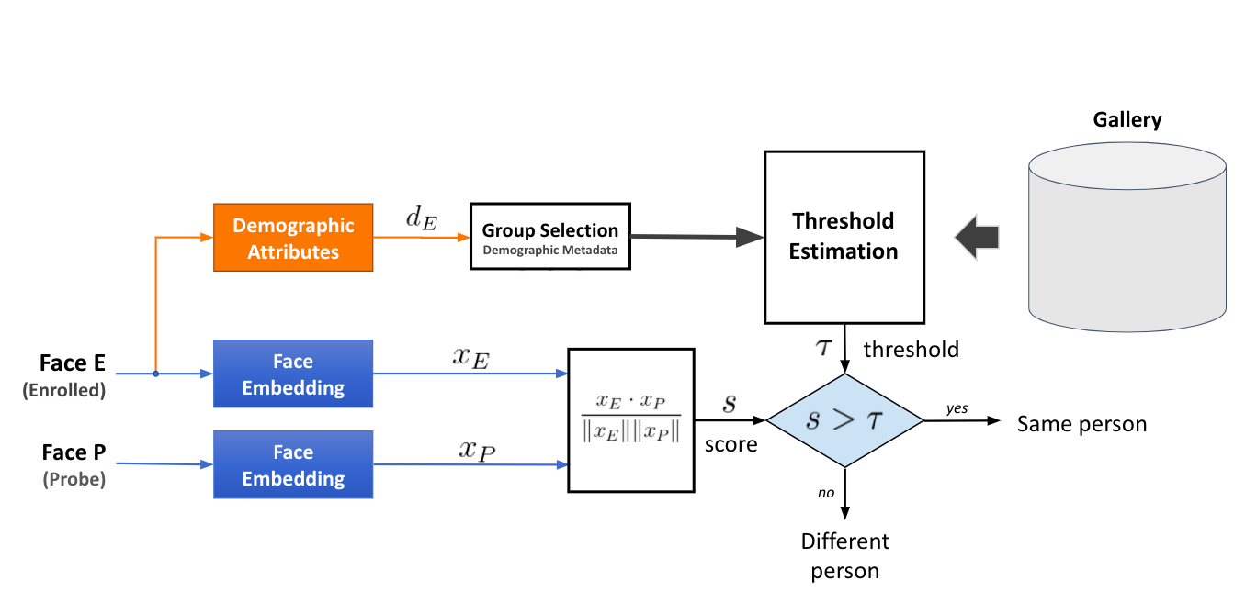
Another option... use demographic thresholds
Introduction - Related Work - Proposed Methods - Methodology - Results - Conclusions
Demographic group-based threshold selection
Threshold for
Caucasian
Threshold for
African American
(c) Esteban Villalobos & Vitor Albeiro

Slide 25

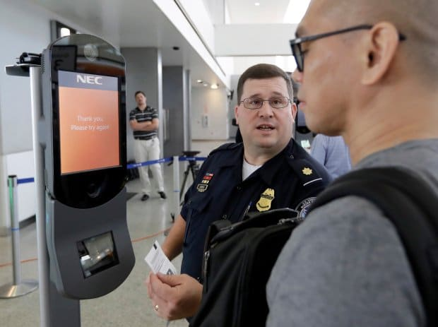

Should we use demographics in operational settings?
🤬
I’m Alaska Native
Introduction - Related Work - Proposed Methods - Methodology - Results - Conclusions
Excuse me Sir, our algorithm says that you are an afro-american male... Is it OK with you?
Problem #1: Defining the demographic group
How specific should the group be?
E.g.: only gender vs gender+race+age
In the case of race, how many should we define?
(Requires an exhaustive list)
I’m non-binary
Problem #2: Demographic groups are considered sensitive information
Both requesting and predicting demographic groups can be deemed controversial for facial recognition
(c) Esteban Villalobos
Image retrieved from: https://www.biometricupdate.com/202007/u-s-homeland-security-biometrics-leaders-discuss-public-engagement-privacy-and-legislation
Notes:
Explicar con situación

Slide 26
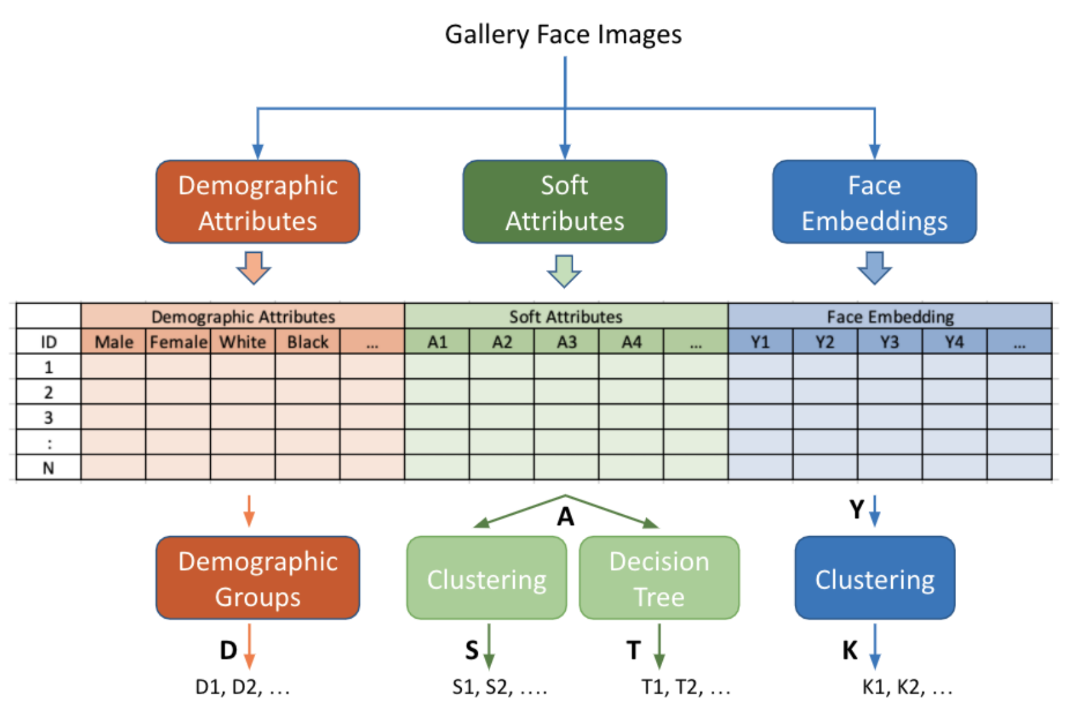
(c) Esteban Villalobos

Slide 27
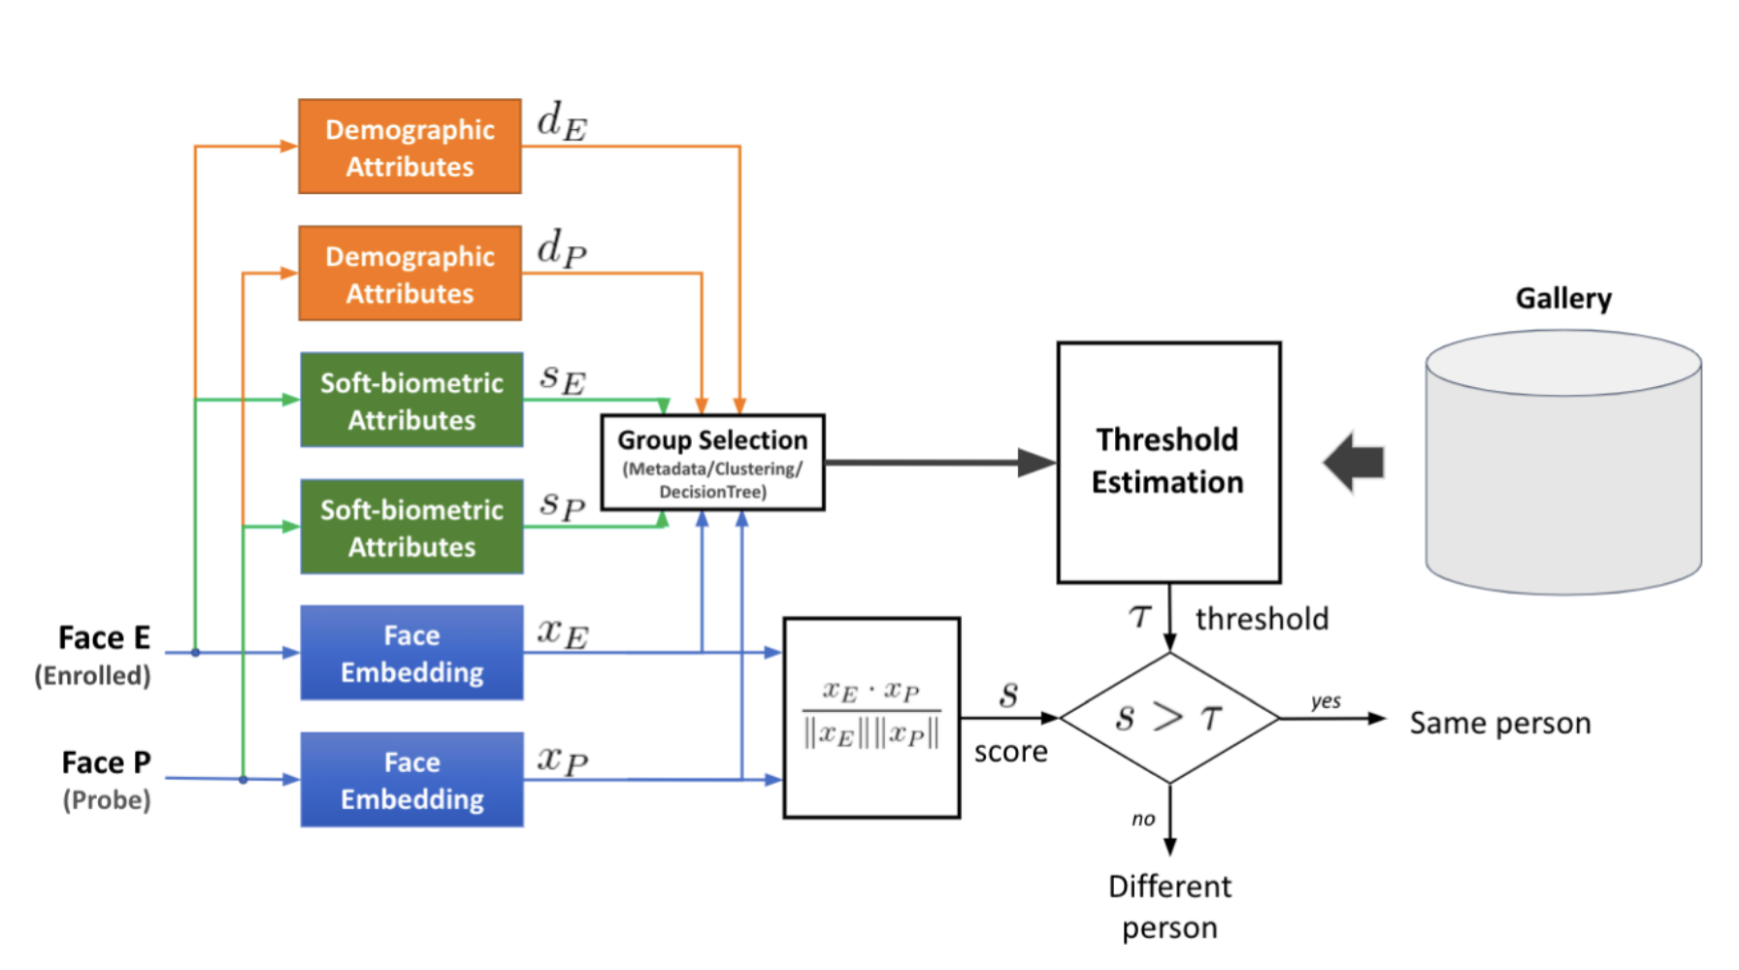
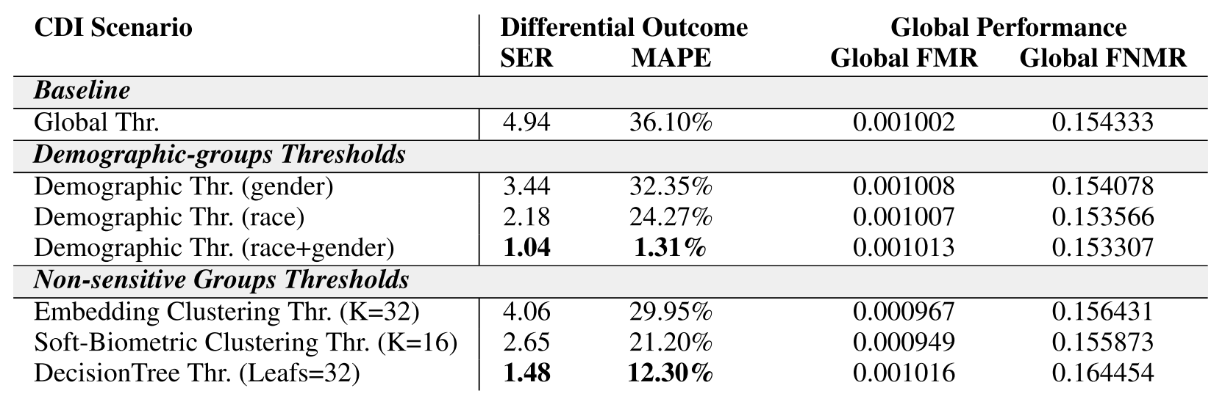
Villalobos E, Mery D, Bowyer K. Fair Face Verification by Using Non-Sensitive Soft-Biometric Attributes. IEEE Access. 2022 Mar 11;10:30168-79.

Slide 28
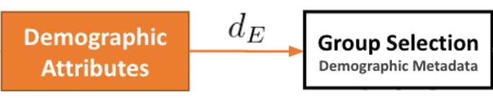
Another option... using demographic thresholds
Standard Facial Verification Approach
sc

Slide 29
Should we use demographics in operational settings?
🤬
I’m Alaska Native
Introduction - Related Work - Proposed Methods - Methodology - Results - Conclusions
Excuse me Sir, our algorithm says that you are an afro-american male...
Is it OK with you?
How to define a Demographic Group?
How specific should the group be?
only gender? or gender+race+age?
How many “races” should be defined?
Do we use an exhaustive list?
I’m non-binary
How to deal with sensitive information?
Both requesting and predicting demographic groups can be deemed controversial for facial recognition
(c) Esteban Villalobos
Image retrieved from: https://www.biometricupdate.com/202007/u-s-homeland-security-biometrics-leaders-discuss-public-engagement-privacy-and-legislation
Notes:
Explicar con situación

Slide 31

Another option... using soft attributes
Standard Facial Verification Approach
sc

Slide 32
Villalobos E, Mery D, Bowyer K. Fair Face Verification by Using Non-Sensitive Soft-Biometric Attributes. IEEE Access. 2022 Mar 11;10:30168-79.

Slide 33
Statistics
same person
Set of Images A
Set of Images B
Face i of set A and Face i of Set B are from the same person.
Face i of set A and Face j of set B for i=j are from different persons.
Face
1
Face
1
Face
2
Face
2
:
:
:
:
Face
m
Face
m
:
:
m x n elements
m x n elements

Slide 34
Statistics
different persons
Set of Images A
Set of Images B
Face i of set A and Face i of Set B are from the same person.
Face i of set A and Face j of set B for i=j are from different persons.
Face
1
Face
1
Face
2
Face
2
:
:
:
:
Face
m
Face
m
:
:
m x n elements
m x n elements

Slide 35
Statistics
d⁺: Diagonal : positive pairs (genuines)
d⁻: Non-Diagonal: negative pairs (impostors)
m x m
elements
Similarity between Face-i of set A and Face-j of set B

Slide 36
Statistics
d⁺: Diagonal : positive pairs (genuines)
d⁻: Non-Diagonal: negative pairs (impostors)
m x m
elements
Similarity between Face-i of set A and Face-j of set B

Slide 37
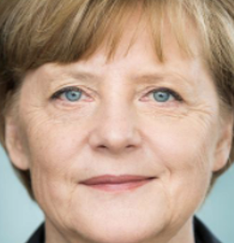

Probability density frequency
ERROR: FMR
ERROR: FNMR
S
Faces of different persons, but they were matched
Faces of the same person, but there is no match
FNMR
False Non-Match Rate
FMR
False Match Rate
threshold

Slide 38
Probability density frequency
S
FNMR
False Non-Match Rate
FMR
False Match Rate

Slide 39
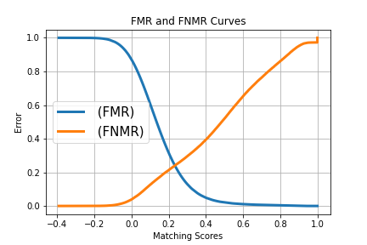
Variando el umbral se obtienen distintos valores de FMR y FNMR:

Slide 40
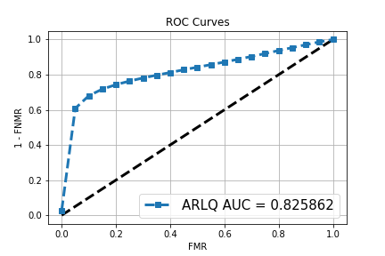
Variando el umbral se obtienen distintos valores de FMR y FNMR:

Slide 41
Ejemplo para evaluar métrica de desempeño del algoritmo:
Distribution of d-
Distribution of d+
Probability density frequency
S
Performance:
Area of each distribution = 1

Slide 42
Ejemplo para evaluar métrica de desempeño del algoritmo:
Examples of d’
for different algorithms
d’ = 0.20
d’ = 1.59
d’ = 2.22
d’ = 3.23
The best one

Slide 43
Es el desempeño de un algoritmo igual para todos los grupos demográficos?
Lamentablemente, no …

Slide 44
BIAS / Sesgo
Desde el punto de vista estadístico, el sesgo es una desviación sistémica causada por un proceso de estimación o muestreo inexacto. Como resultado, la distribución de una variable podría estar sesgada con respecto a la distribución original, posiblemente desconocida. [Baeza-Yates, 2018: https://dl.acm.org/doi/fullHtml/10.1145/3209581 ]
En biometría, un algoritmos sesgado (con bias) entrega respuestas estadísticamente diferentes (decisiones) para diferentes grupos de personas, como por ejemplo de distinto sexo, edad y color de piel. [Rathgeb, 2021: https://arxiv.org/abs/2105.14844]

Slide 45
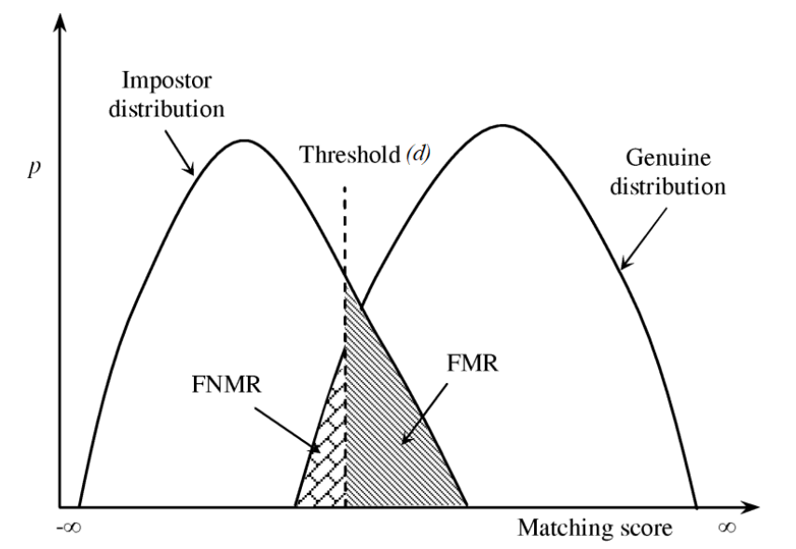
Metrics in Facial Verification
Introduction - Related Work - Proposed Methods - Methodology - Results - Conclusions
False Non-Match Rate (FNMR)
Ratio of times a genuine comparison was rejected.
False Match Rate (FMR)
Ratio of times an imposter comparison was accepted.
(Howard, 2019)
© Esteban Villalobos: Fair Face Verification by Using Non-Sensitive Soft-Biometric Attributes, UC, 2021

Slide 46
Metrics in Facial Verification
False Non-Match Rate (FNMR)
Ratio of times a genuine comparison was rejected.
False Match Rate (FMR)
Ratio of times an imposter comparison was accepted.
May lead to more undesirable outcomes (e.g. false arrests)
© Esteban Villalobos: Fair Face Verification by Using Non-Sensitive Soft-Biometric Attributes, UC, 2021

Slide 47
Facial Verification Problem
Introduction - Related Work - Proposed Methods - Methodology - Results - Conclusions
Standard Facial Verification Approach
© Esteban Villalobos: Fair Face Verification by Using Non-Sensitive Soft-Biometric Attributes, UC, 2021

Slide 48
Facial Verification Problem
Introduction - Related Work - Proposed Methods - Methodology - Results - Conclusions
Standard Facial Verification Approach
Feature Extraction
© Esteban Villalobos: Fair Face Verification by Using Non-Sensitive Soft-Biometric Attributes, UC, 2021

Slide 49
Facial Verification Problem
Introduction - Related Work - Proposed Methods - Methodology - Results - Conclusions
Standard Facial Verification Approach
Compute similarity
© Esteban Villalobos: Fair Face Verification by Using Non-Sensitive Soft-Biometric Attributes, UC, 2021

Slide 50
Facial Verification Problem
Introduction - Related Work - Proposed Methods - Methodology - Results - Conclusions
Standard Facial Verification Approach
Make decision
© Esteban Villalobos: Fair Face Verification by Using Non-Sensitive Soft-Biometric Attributes, UC, 2021

Slide 51
Facial Verification Problem
Introduction - Related Work - Proposed Methods - Methodology - Results - Conclusions
Standard Facial Verification Approach
© Esteban Villalobos: Fair Face Verification by Using Non-Sensitive Soft-Biometric Attributes, UC, 2021

Slide 52
Threshold Estimation
Introduction - Related Work - Proposed Methods - Methodology - Results - Conclusions
1) Determine the “Policy FMR”
Policymakers decide a FMR that is deemed “safe” for the system
E.g.:
1 false match every 1.000 comparisons
1 false match every 10.000 comparisons
© Esteban Villalobos: Fair Face Verification by Using Non-Sensitive Soft-Biometric Attributes, UC, 2021

Slide 53
Threshold Estimation
Introduction - Related Work - Proposed Methods - Methodology - Results - Conclusions
1) Determine the “Policy FMR”
Policymakers decide a FMR that is deemed “safe” for the system
E.g.:
1 false match every 1.000 comparisons
1 false match every 10.000 comparisons
2) Global threshold estimation
Set a global threshold that achieves the Policy FMR on the training data
This threshold will be used in all comparisons
© Esteban Villalobos: Fair Face Verification by Using Non-Sensitive Soft-Biometric Attributes, UC, 2021

Slide 54
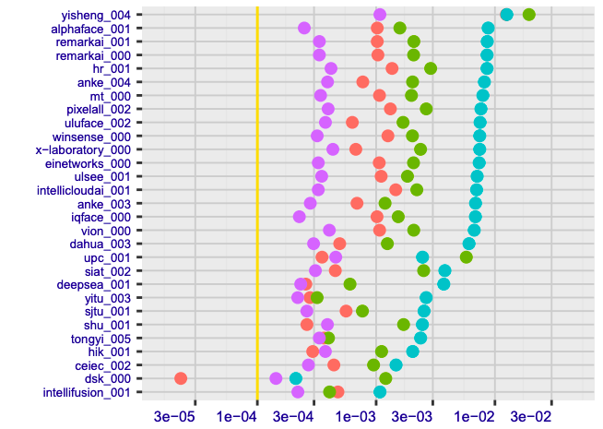
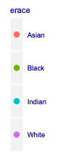
Threshold Estimation
Introduction - Related Work - Proposed Methods - Methodology - Results - Conclusions
PROBLEM:
Setting a FMR using a global threshold does not ensure that all demographics fall below it. According to the National Institute of Standards and Technology (NIST), many algorithms had FMRs that varied by factors of 10 or 100 for different demographic groups.
Policy FMR
(NIST, 2019)

Slide 55
Another option... use demographic thresholds
Introduction - Related Work - Proposed Methods - Methodology - Results - Conclusions
Demographic group-based threshold selection
© Esteban Villalobos: Fair Face Verification by Using Non-Sensitive Soft-Biometric Attributes, UC, 2021

Slide 56
Another option... use demographic thresholds
Introduction - Related Work - Proposed Methods - Methodology - Results - Conclusions
1) Determine the “Policy FMR”
Policymakers decide a FMR that is deemed “safe” for the system
2) Demographic threshold estimation
Set a variable threshold that achieves the Policy FMR on each demographic group
3) Threshold selection
Use choose the threshold according to the demographic group of the enrolled identity
Benefit:
Ensures that each demographic group falls below the Policy FMR
© Esteban Villalobos: Fair Face Verification by Using Non-Sensitive Soft-Biometric Attributes, UC, 2021

Slide 57
Should we use demographics in operational settings?
Introduction - Related Work - Proposed Methods - Methodology - Results - Conclusions
Problem #1: Defining the demographic group
How specific should the group be?
E.g.: only gender vs gender+race+age
In the case of race, how many should we define?
(Requires an exhaustive list)
© Esteban Villalobos: Fair Face Verification by Using Non-Sensitive Soft-Biometric Attributes, UC, 2021
Image retrieved from: https://www.biometricupdate.com/202007/u-s-homeland-security-biometrics-leaders-discuss-public-engagement-privacy-and-legislation
Notes:
Explicar con situación

Slide 58
Should we use demographics in operational settings?
Introduction - Related Work - Proposed Methods - Methodology - Results - Conclusions
Problem #2: Demographic groups are considered sensitive information
Both requesting and predicting demographic groups can be deemed controversial for facial recognition
© Esteban Villalobos: Fair Face Verification by Using Non-Sensitive Soft-Biometric Attributes, UC, 2021
Image retrieved from: https://www.biometricupdate.com/202007/u-s-homeland-security-biometrics-leaders-discuss-public-engagement-privacy-and-legislation
Notes:
Explicar con situación

Slide 59
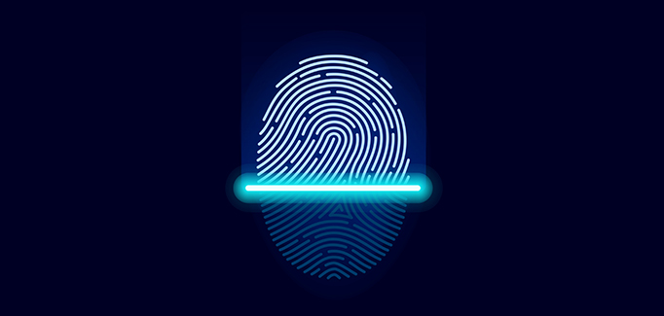
BIOMETRÍA
La biometría representa un componente esencial de muchos sistemas de vigilancia, control de acceso y gestión operativa de la identidad, por lo que afecta directa o indirectamente a miles de millones de personas en todo el mundo.

Slide 60
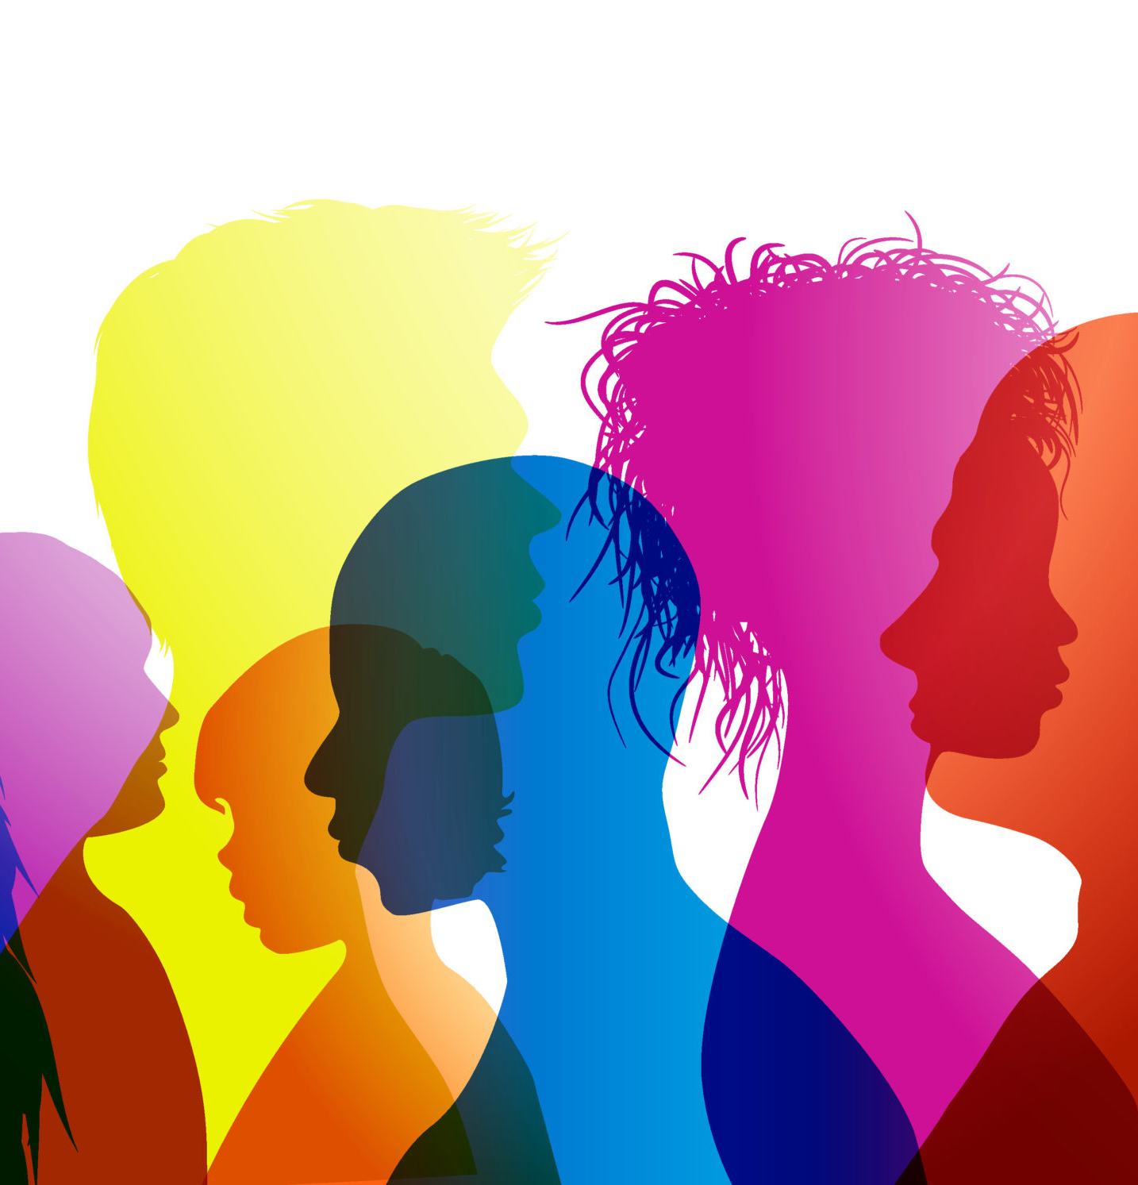
BIOMETRÍA
Los sistemas algorítmicos de decisión han sido tachados con frecuencia de "parciales", "racistas", "sexistas" o "injustos" por numerosos medios de comunicación, organizaciones e investigadores. Existe un debate permanente sobre si estas valoraciones están justificadas y si los ciudadanos y los responsables políticos deberían preocuparse. Estas y otras cuestiones relacionadas se han convertido recientemente en un tema candente en el contexto de las tecnologías biométricas, que son omnipresentes en las aplicaciones personales, comerciales y gubernamentales.
[Rathgeb, 2021: https://arxiv.org/abs/2105.14844]

Slide 61
Vangara, K., King, M. C., Albiero, V., & Bowyer, K. (2019). Characterizing the variability in face recognition accuracy relative to race. In Proceedings of the IEEE/CVF Conference on Computer Vision and Pattern Recognition Workshops
https://arxiv.org/abs/1904.07325

Slide 62
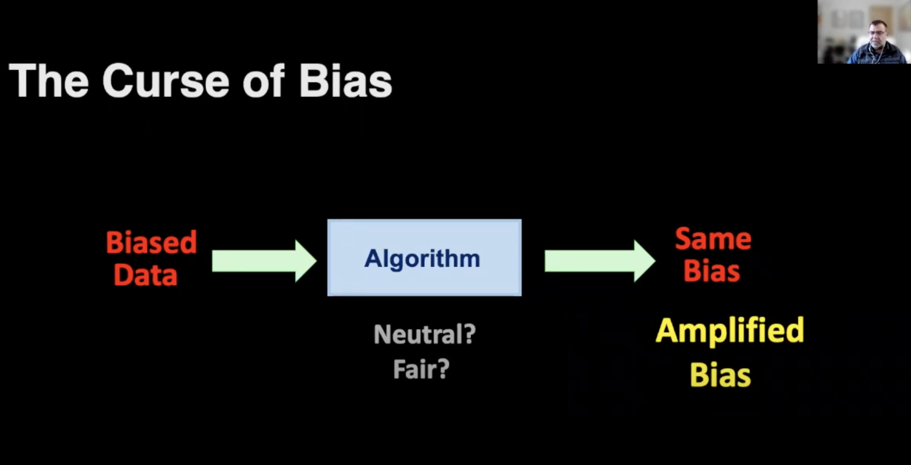
© Talk: Ethics in AI: A Challenging Task - Ricardo Baeza-Yates
https://youtu.be/rMU9pJCyJYY

Slide 63
Los datos proporcionados por el ser humano pueden estar sesgados...
pero no sólo esa es la fuente del sesgo…

Slide 64
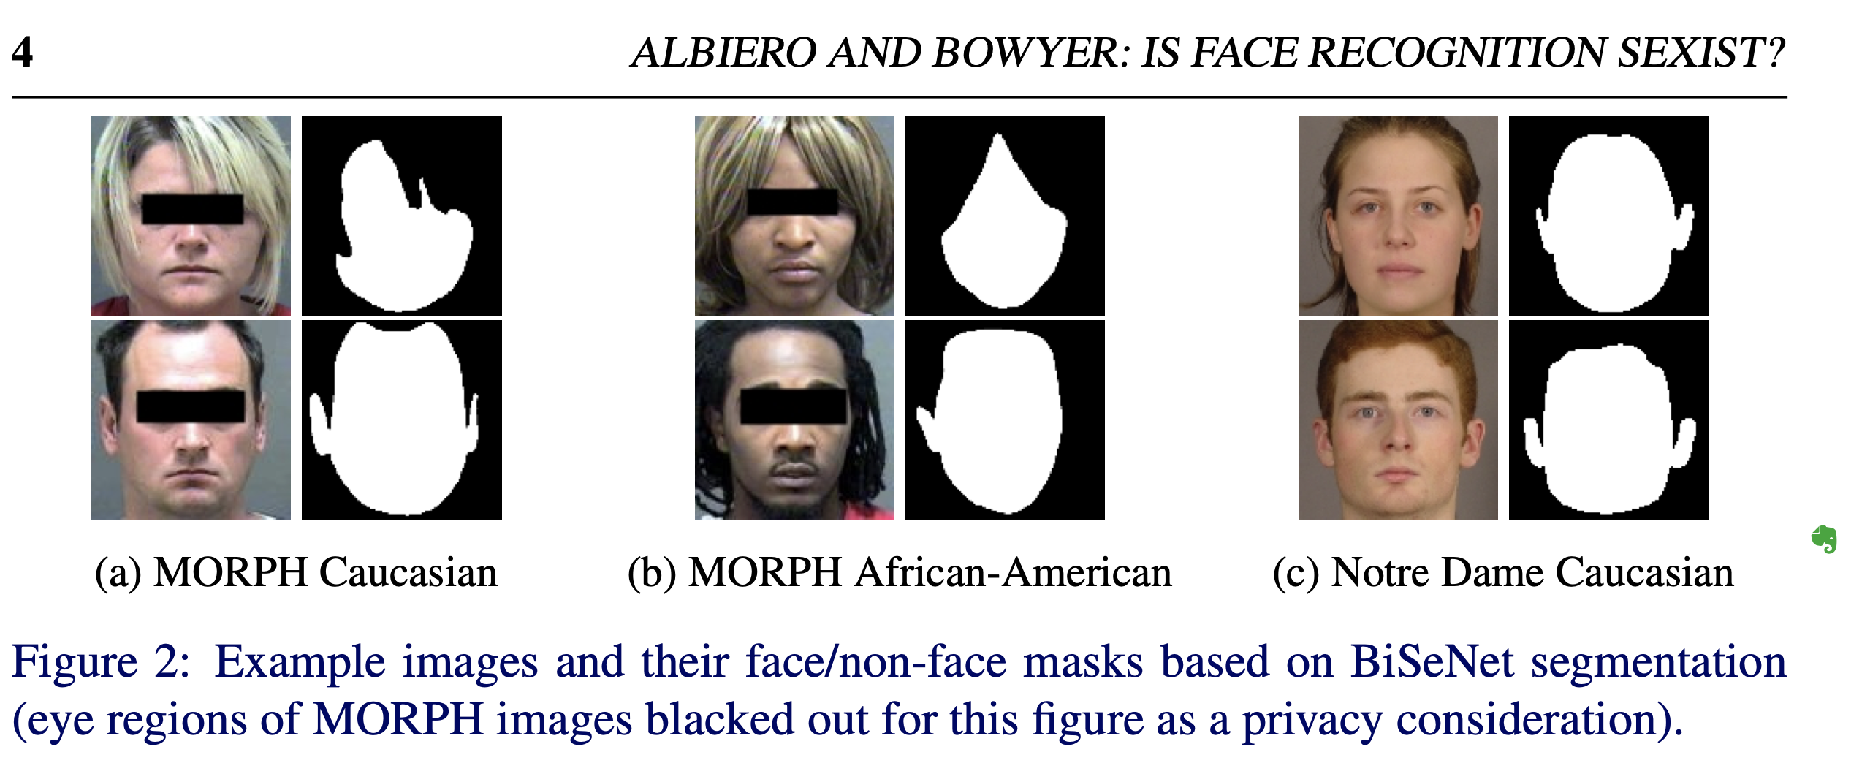
https://arxiv.org/pdf/2008.06989.pdf

Slide 65
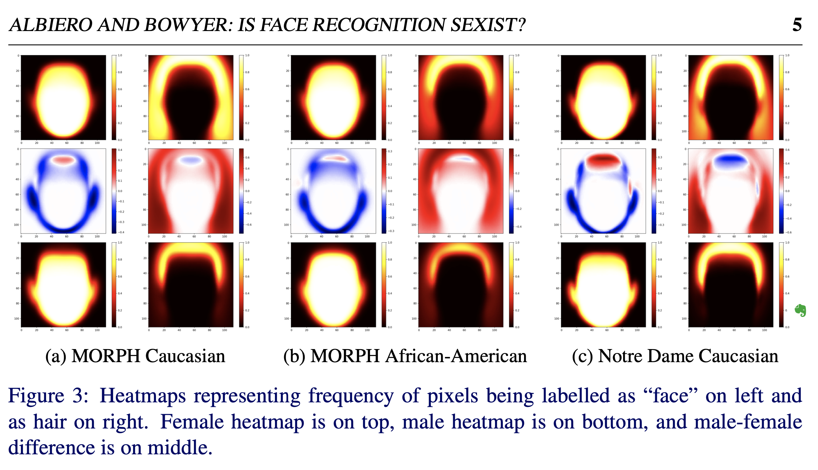
face
hair
face
hair
face
hair
female
delta
The data provided by human can be highly-biased.
male
Los mapas de calor dejan claro que, por término medio, las imágenes de rostros femeninos contienen menos "píxeles en la cara" que las imágenes de rostros masculinos, y que los peinados de género son una de las principales causas subyacentes.
https://arxiv.org/pdf/2008.06989.pdf

Slide 66
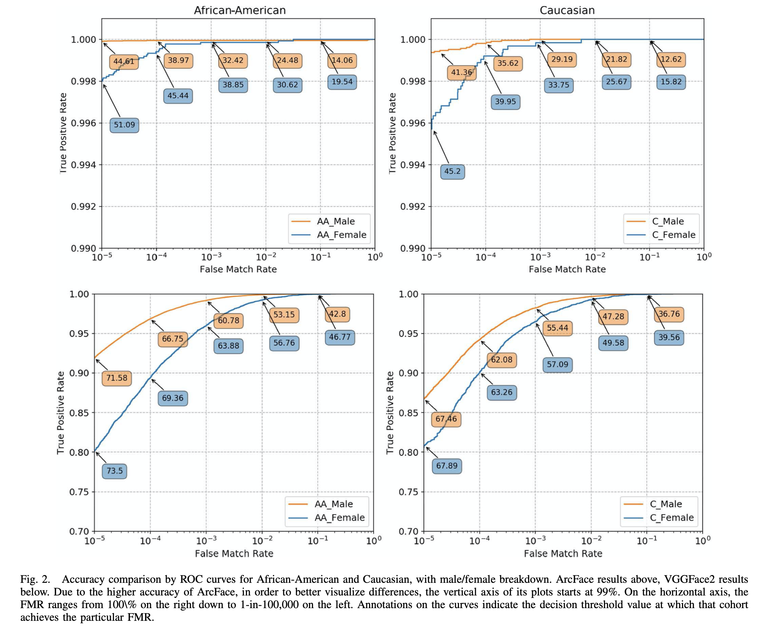
ArcFace
VGGFace2
Krishnapriya, K. S., Albiero, V., Vangara, K., King, M. C., & Bowyer, K. W. (2020). Issues Related to Face Recognition Accuracy Varying Based on Race and Skin Tone. IEEE Transactions on Technology and Society, 1(1), 8-20.

Slide 67
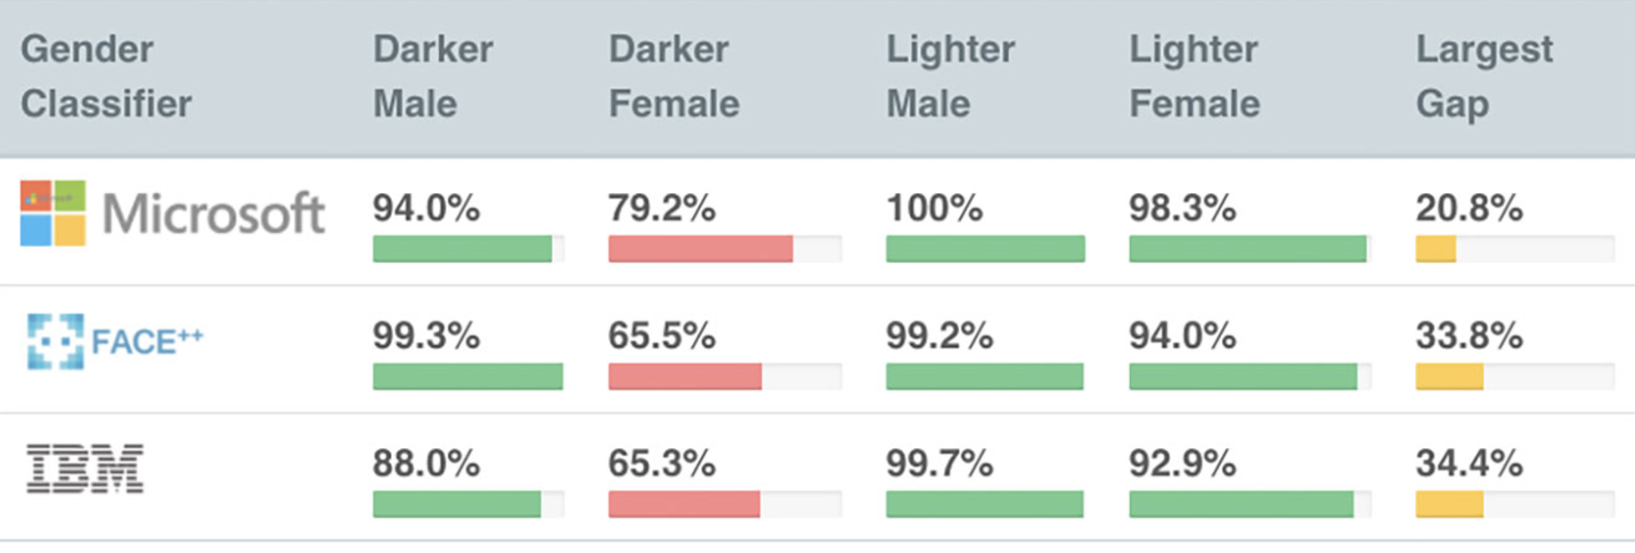

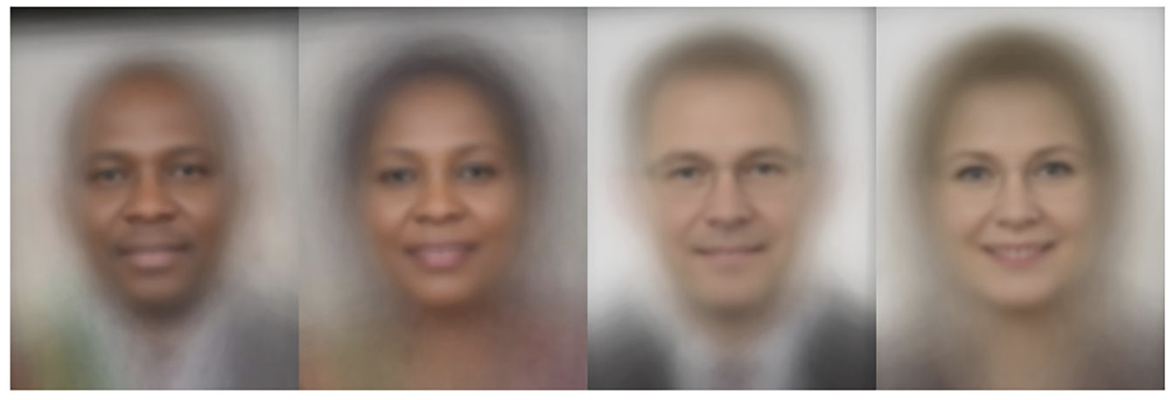
98.7% 68.6% 100% 92.9% 30.4%
https://venturebeat.com/2019/01/24/amazon-rekognition-bias-mit/
https://towardsdatascience.com/navigating-the-sea-of-explainability-649672aa7bdd

Slide 68
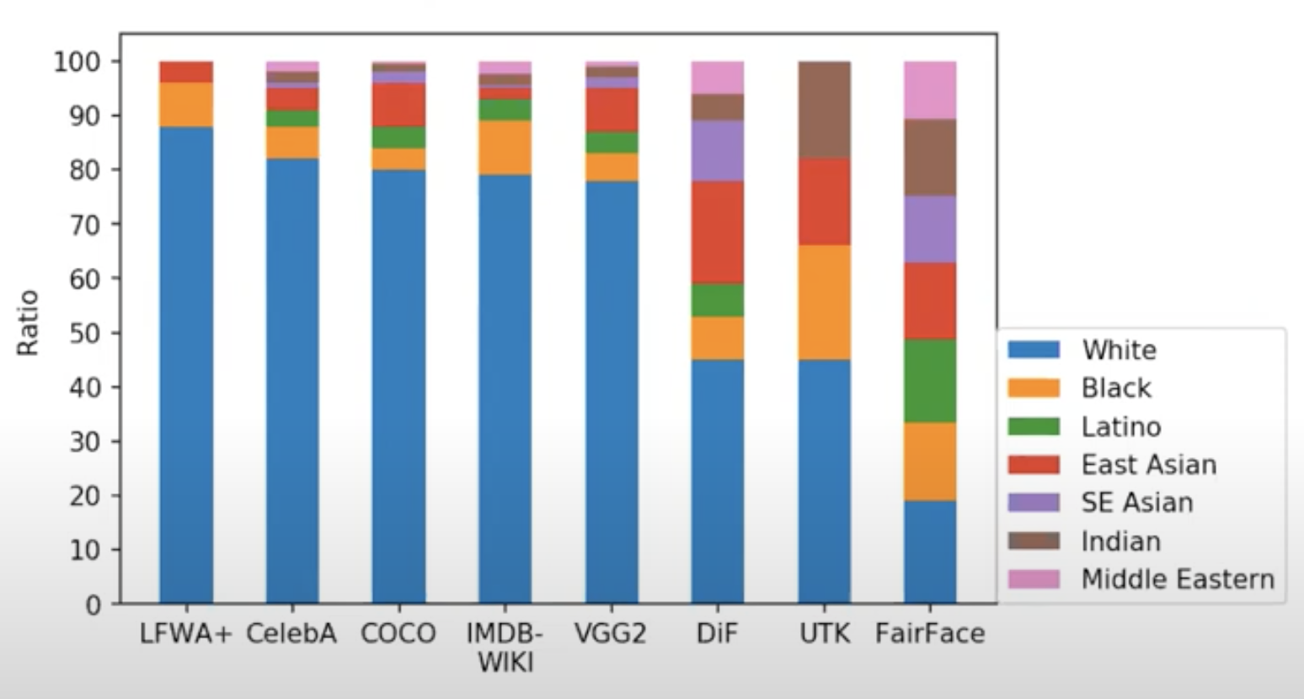
Bias in Face Datasets
https://www.youtube.com/watch?v=uM1pXE2JDUA

Slide 69
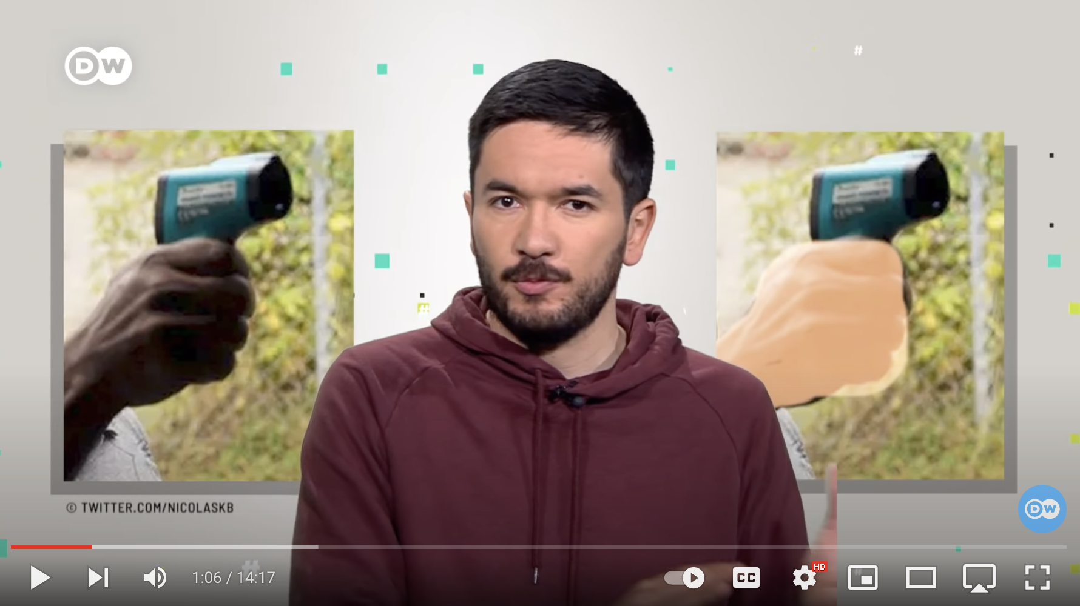
¿Cómo discrimina la inteligencia artificial? ¿Quienes son sus víctimas? (ver desde 7:27)
https://youtu.be/mWGzicjqAc0

Slide 70
Ejemplo en la Justicia

Slide 71
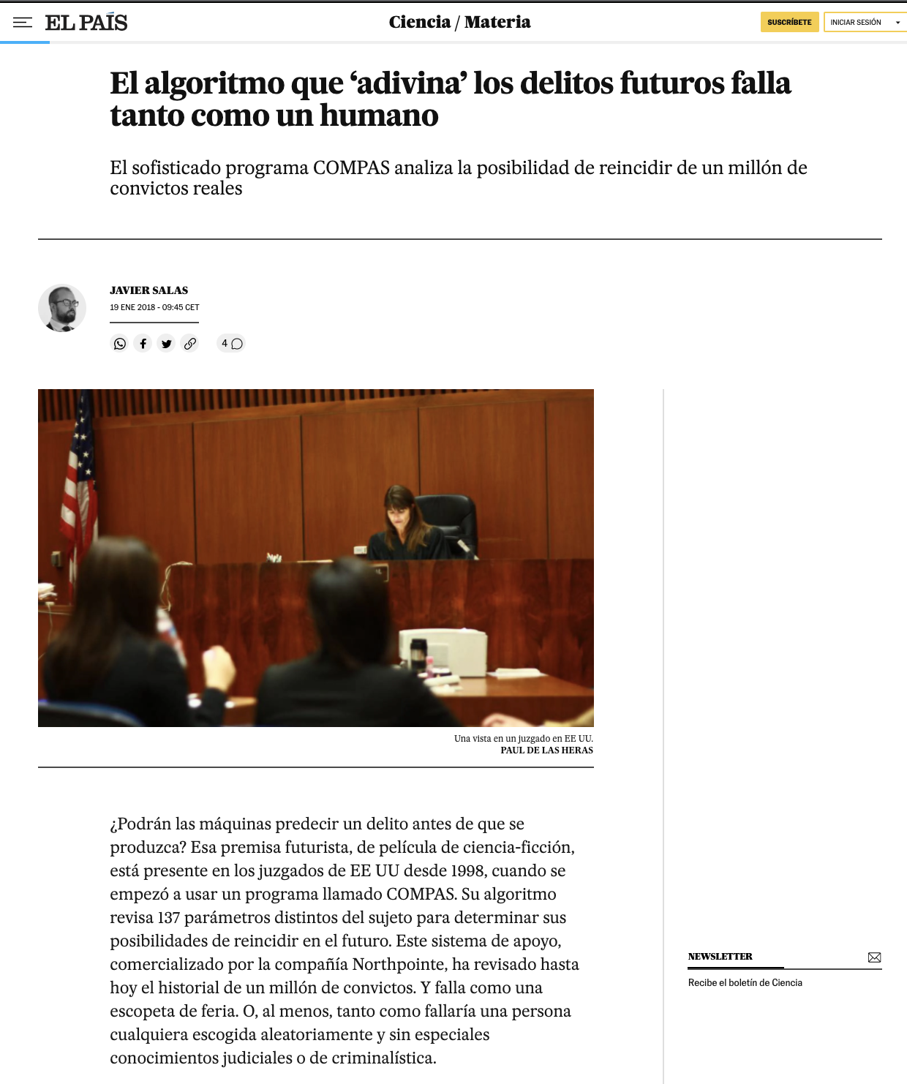
COMPAS
El software COMPAS predice la probabilidad de que una persona reincida y utiliza factores como la pobreza, la falta de empleo y otras variables (aunque la raza no se incluye directamente en su evaluación), y es utilizado por los jueces para calibrar la dureza y la duración de las penas.
https://algorithmia.com/blog/racial-bias-in-facial-recognition-software
https://elpais.com/elpais/2018/01/17/ciencia/1516194073_122982.html

Slide 72
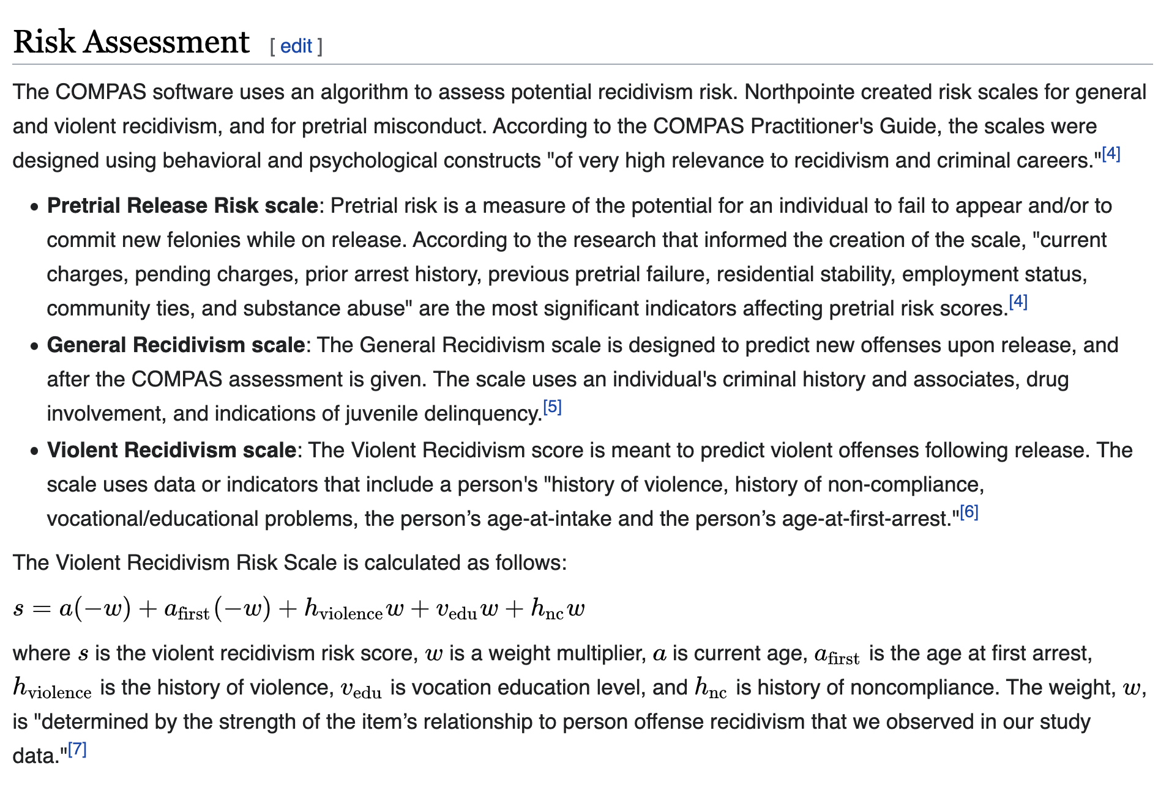
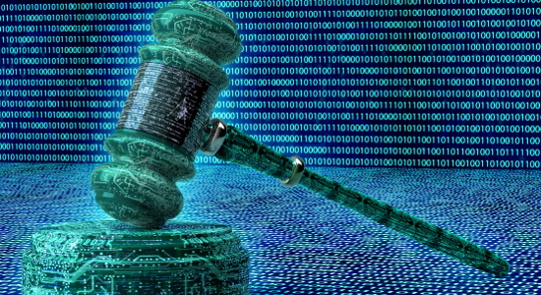
COMPAS
El software COMPAS predice la probabilidad de que una persona reincida y utiliza factores como la pobreza, la falta de empleo y otras variables (aunque la raza no se incluye directamente en su evaluación), y es utilizado por los jueces para calibrar la dureza y la duración de las penas.
https://algorithmia.com/blog/racial-bias-in-facial-recognition-software
https://en.wikipedia.org/wiki/COMPAS_(software)

Slide 73
COMPAS
COMPAS
Atributos de
una persona acusada
probabilidad de que una persona reincida
Clasificado como ▼ | NO-REINCIDE | REINCIDE
BAJO RIESGO | TN | FN
ALTO RIESGO | FP | TP

Slide 74
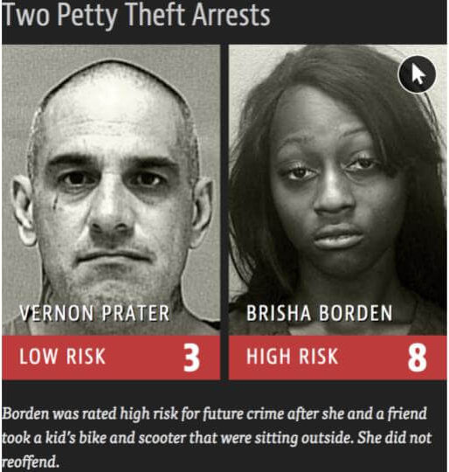
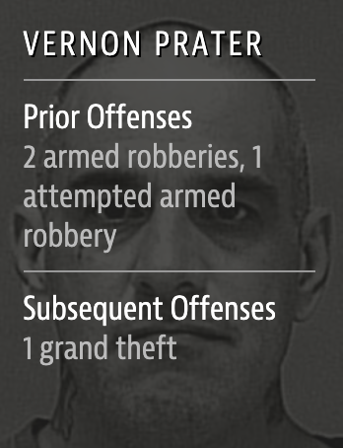
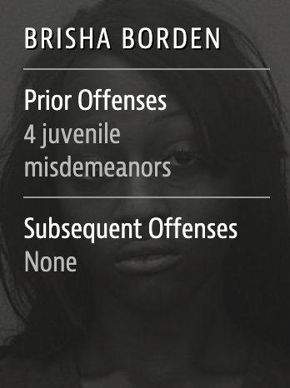
COMPAS
Ejemplo del resultado del modelo de Propublica basado en el software de evaluación de riesgos llamado COMPAS
https://algorithmia.com/blog/racial-bias-in-facial-recognition-software

Slide 75
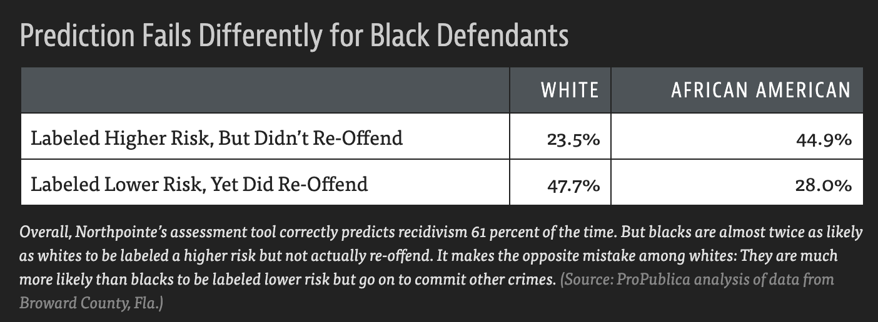
COMPAS
Clasificado como ▼ | NO-REINCIDE | REINCIDE
BAJO RIESGO | TN | FN
ALTO RIESGO | FP | TP
FP
FN
https://www.propublica.org/article/machine-bias-risk-assessments-in-criminal-sentencing

Slide 76
Ejemplo en la contratación de personas

Slide 77
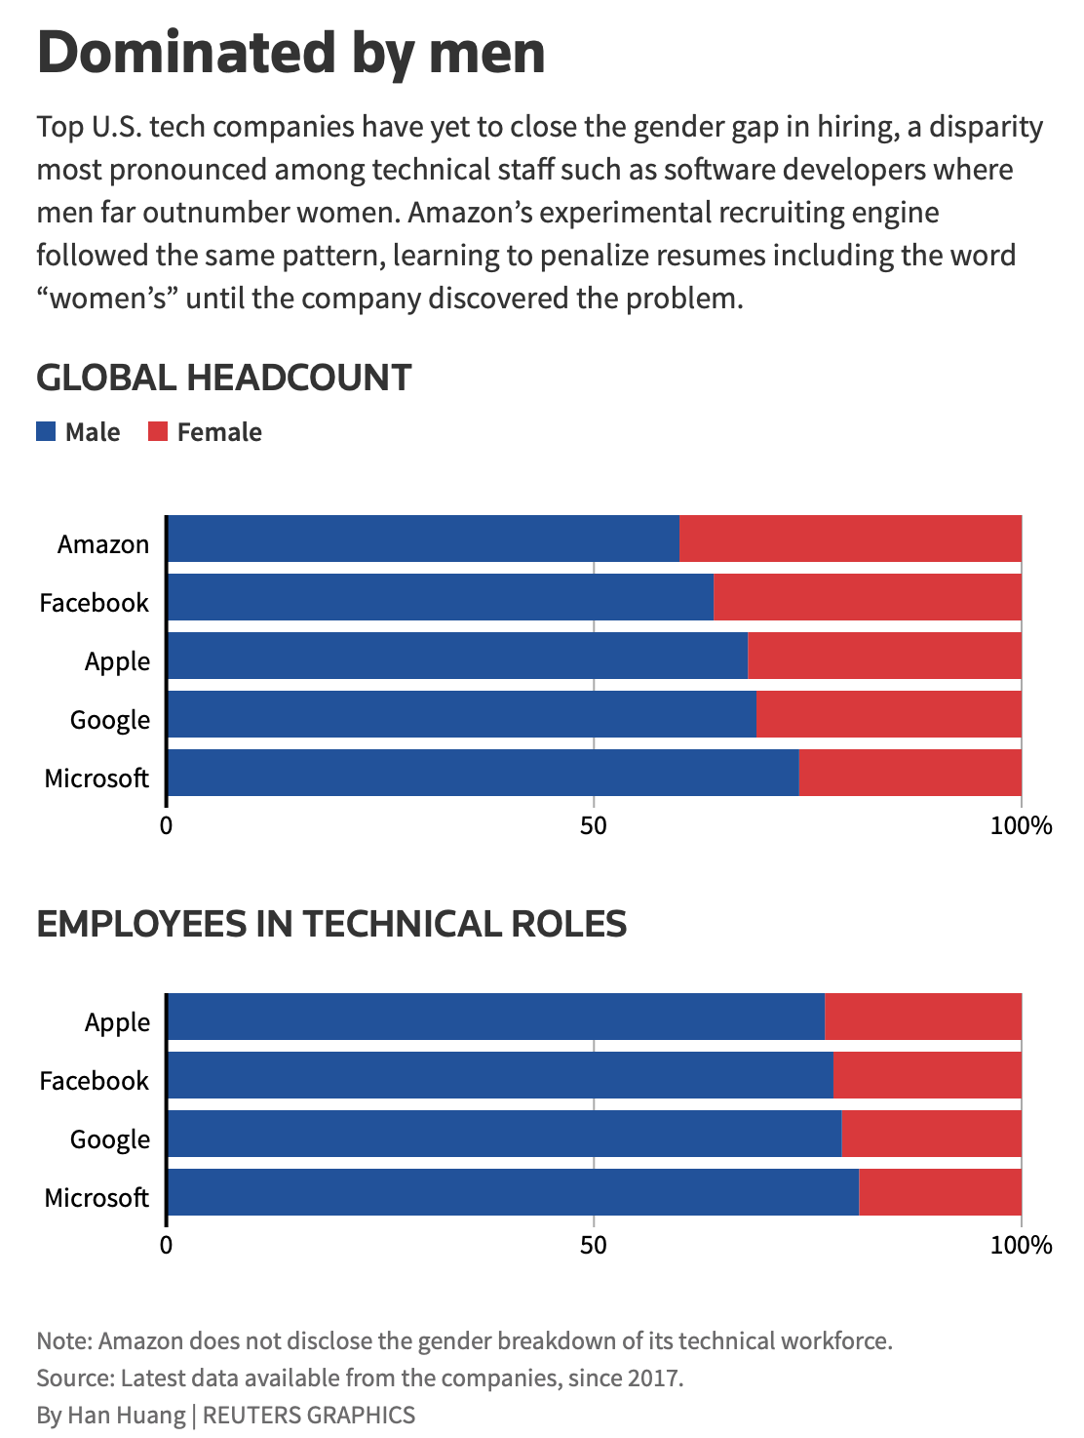
Amazon scraps secret AI recruiting tool that showed bias against women
Los especialistas en aprendizaje automático de Amazon.com Inc. AMZN.O descubrieron un gran problema: a su nuevo motor de reclutamiento no le gustaban las mujeres
https://www.reuters.com/article/us-amazon-com-jobs-automation-insight/amazon-scraps-secret-ai-recruiting-tool-that-showed-bias-against-women-idUSKCN1MK08G

Slide 78
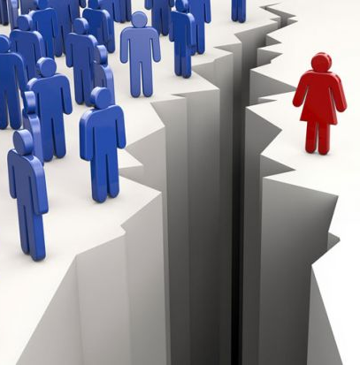
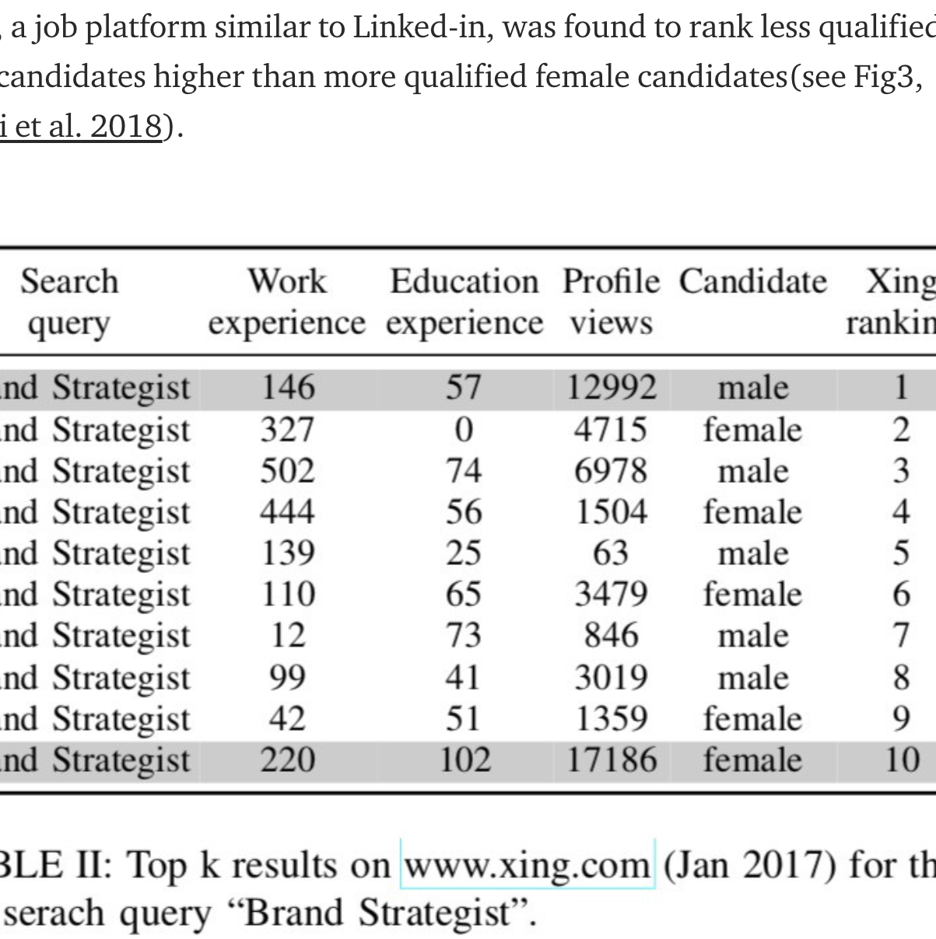
https://arxiv.org/pdf/1806.01059.pdf

Slide 79
Ejemplo en análisis de texto

Slide 80

https://towardsdatascience.com/gender-bias-word-embeddings-76d9806a0e17

Slide 81

El sesgo de género a través de las nubes de palabras
Palabras vecinas (usando KNN) a las palabras ‘man’ y ‘woman’.
https://towardsdatascience.com/gender-bias-word-embeddings-76d9806a0e17

Slide 82

© Talk: Ethics in AI: A Challenging Task - Ricardo Baeza-Yates
https://youtu.be/rMU9pJCyJYY

Slide 83
© Talk: Ethics in AI: A Challenging Task - Ricardo Baeza-Yates
https://youtu.be/rMU9pJCyJYY

Slide 84
© Talk: Ethics in AI: A Challenging Task - Ricardo Baeza-Yates
https://youtu.be/rMU9pJCyJYY

Slide 85
Ejemplo en generación de imágenes

Slide 86


Given a low-resolution input image, model generates high-resolution images that are perceptually realistic and downscale correctly
https://twitter.com/Chicken3gg/status/1274314622447820801
https://www.theverge.com/21298762/face-depixelizer-ai-machine-learning-tool-pulse-stylegan-obama-bias

Slide 87
Causas del Sesgo
https://towardsdatascience.com/a-tutorial-on-fairness-in-machine-learning-3ff8ba1040cb

Slide 88
Muestras sesgadas
Si por casualidad se produce algún sesgo inicial, dicho sesgo puede agravarse con el tiempo: las observaciones futuras confirman la predicción y hay menos oportunidades de realizar observaciones que la contradigan.
Ejemplo: El registro de delitos sólo procede de los delitos observados por la policía. El departamento de policía tiende a enviar más agentes al lugar en el que se ha detectado una mayor tasa de delincuencia inicialmente y, por tanto, es más probable que registre delitos en dichas regiones. El sistema de predicción entrenado con datos recogidos de esta manera tiende a tener un sesgo positivo hacia las regiones con menos policía.

Slide 89
Datos contaminados
Cualquier sistema de Machine Learning puede mantener el sesgo existente en los datos antiguos causado por el sesgo humano. Por ejemplo, si un sistema utiliza las decisiones de contratación tomadas por un directivo como etiquetas para seleccionar a los solicitantes (en lugar de la capacidad de los solicitantes de empleo). El sistema entrenado con estas muestras reproducirá el sesgo existente en las decisiones del directivo.

Slide 90
Features limitadas
Las features (características) pueden ser menos informativas o fiables para los grupos minoritarios. Si la fiabilidad de la etiqueta de un grupo minoritario es mucho menor que la de su homólogo del grupo mayoritario, el sistema tiende a tener una precisión mucho menor para la predicción del grupo minoritario debido a estos ruidos.

Slide 91
Disparidad del tamaño de la muestra
Si los datos de entrenamiento procedentes del grupo minoritario son mucho menos que los procedentes del grupo mayoritario, es menos probable que se modele perfectamente el grupo minoritario.

Slide 92
Proxies
Incluso si el atributo sensible (atributos que se considera que no deben utilizarse para una tarea, por ejemplo, raza/género) no se utiliza para entrenar un sistema de Machine Learning, siempre puede haber otras características que sean proxies del atributo sensible (por ejemplo, el lugar de residencia). Si se incluyen estas características, el sesgo seguirá existiendo. A veces, es muy difícil determinar si una característica relevante está demasiado correlacionada con las características protegidas y si debemos incluirla en el entrenamiento.

Slide 93

An example of AI bias reflecting global inequalities
https://www.theverge.com/platform/amp/2019/6/11/18661128/ai-object-recognition-algorithms-bias-worse-household-items-lower-income-countries

Slide 94

An example of AI bias reflecting global inequalities
https://research.fb.com/wp-content/uploads/2019/06/Does-Object-Recognition-Work-for-Everyone.pdf

Slide 95

An example of AI bias reflecting global inequalities
https://research.fb.com/wp-content/uploads/2019/06/Does-Object-Recognition-Work-for-Everyone.pdf

Slide 96

An example of AI bias reflecting global inequalities
https://research.fb.com/wp-content/uploads/2019/06/Does-Object-Recognition-Work-for-Everyone.pdf

Slide 97


Slide 98
Fairness in Facial Recognition
Introduction - Related Work - Proposed Methods - Methodology - Results - Conclusions
Bias Mitigation Strategies
Pre-Processing
In-Processing
Post-Processing
Before model training
During model training
After model training
© Esteban Villalobos: Fair Face Verification by Using Non-Sensitive Soft-Biometric Attributes, UC, 2021

Slide 99
Fairness in Facial Recognition
Introduction - Related Work - Proposed Methods - Methodology - Results - Conclusions
Bias Mitigation Strategies
Pre-Processing
In-Processing
Post-Processing
Unfortunately, balanced training data does not imply that algorithms achieve balanced accuracy measures.
(Albiero et al., 2020)
There has been a lot of work to build and training on balanced datasets
(Kärkkäinen and Joo, 2019; Wang et al., 2019; Wang and Deng, 2020; Zhang and Deng, 2020; Robinson et al., 2020)
© Esteban Villalobos: Fair Face Verification by Using Non-Sensitive Soft-Biometric Attributes, UC, 2021

Slide 100
Fairness in Facial Recognition
Introduction - Related Work - Proposed Methods - Methodology - Results - Conclusions
Bias Mitigation Strategies
Pre-Processing
In-Processing
Post-Processing
Some works have proposed using:
Adversarial networks
(Gong et al. 2020, Morales et al. 2020)
Reinforcement learning learning
(Wang et al. 2020)
Adding penalization terms
(Xu et al., 2021)
This can be very computationally expensive and is not compatible with black-box models
© Esteban Villalobos: Fair Face Verification by Using Non-Sensitive Soft-Biometric Attributes, UC, 2021

Slide 101
Fairness in Facial Recognition
Introduction - Related Work - Proposed Methods - Methodology - Results - Conclusions
Bias Mitigation Strategies
Pre-Processing
In-Processing
Post-Processing
Current approaches explore using
Score calibration
(Terhörst et al., 2020)
Variable thresholds
(Terhörst et al., 2020; Robison et al., 2020)
Advantages
Require fewer computational resources
Can be applied to black-box models
© Esteban Villalobos: Fair Face Verification by Using Non-Sensitive Soft-Biometric Attributes, UC, 2021

Slide 102
FAIRNESS (justicia, equidad, etc.)
Existen muchos artículos que se han dedicado en el último tiempo a tratar de mitigar el problema del sesgo. De aquí surge el término ‘FAIRNESS’ que tiene muchas definiciones y muchos usos.
Por un lado, estos resultados diferenciales en los sistemas biométricos causados por las diferencias de rendimiento demográfico pueden medirse y cuantificarse. Por otro lado, el ‘FAIRNESS’ se considera una construcción social, determinada por el acuerdo general y/o las leyes, que está relacionada con las consecuencias de los resultados diferenciales, es decir, mapea la respuesta/comportamiento de un algoritmo (biométrico) en una aplicación.

Slide 103
Statistical parity
La paridad estadística establece que en entornos de clasificación binaria, los miembros de diferentes grupos deberían tener la misma probabilidad de recibir una predicción positiva.

Slide 104
Disparate/Adverse impact
El impacto dispar plantea que las tasas de clasificación positiva entre dos grupos cualesquiera no deben variar en más del 80%.

Slide 105


Slide 106
Equalized odds / Disparate mistreatment
El principio de equidad de probabilidades igualadas (equalized odds), también conocido como maltrato dispar (disparate mistreatment) requiere que los algoritmos de clasificación realicen predicciones de manera que ningún grupo reciba un número desproporcionadamente mayor de errores falsos positivos o falsos negativos.

Slide 107
Demographic parity
La formulación de paridad demográfica de la equidad no se centra en la pertenencia a un grupo, sino que se basa en la idea de que individuos similares deberían recibir predicciones similares.

Slide 108

Clustering-based strategies
Introduction - Related Work - Proposed Methods - Methodology - Results - Conclusions
Facial Embedding Clustering Strategy
© Esteban Villalobos: Fair Face Verification by Using Non-Sensitive Soft-Biometric Attributes, UC, 2021

Slide 109

Clustering-based strategies
Introduction - Related Work - Proposed Methods - Methodology - Results - Conclusions
2) Soft-Biometric Clustering Strategy
© Esteban Villalobos: Fair Face Verification by Using Non-Sensitive Soft-Biometric Attributes, UC, 2021

Slide 110

Decision Tree-based strategy
Introduction - Related Work - Proposed Methods - Methodology - Results - Conclusions
Decision Tree-based Threshold Selection
© Esteban Villalobos: Fair Face Verification by Using Non-Sensitive Soft-Biometric Attributes, UC, 2021
Notes:
NOT A CLASIFICATION TREE

Slide 111

© Tomado de Ethics in AI: A Challenging Task - Ricardo Baeza-Yates
https://youtu.be/rMU9pJCyJYY

